Slide 1

R
RECOMMENDATION SYSTEM
Project Code: P433
Team Members (Group 1)
Ritesh Singh
Koka Rishitha
Veeramalla Hemanth Kumar
Aakumalla Saadiya
Kante Rahul

Slide 2

CONTENTS
Objective
Data Collection
Data Preprocessing
Exploratory Data Analysis
Model Building and Evaluation
Deployment

Slide 3
Objective
During the last few decades ,with the rise of YouTube, Amazon, Netflix and many other such as web services, Recommender systems have taken more and more important place in our lives
The main objective of this project is to build a Recommendation system to recommend relevant book s to users based on popularity and user interests.

Slide 4
DATA COLLECTION
Data has been collected for the project coordinator. It contains Books, Ratings, and user’s csv files.
Book data set contains - shape is (271360,3)
Rating Data set contains - shape is (1149780,3)
User Data set contains- shape is (278858,3)

Slide 5
DATA PREPROCESSING
Removing the unwanted columns, from the data set. it contains 5 columns (ISBN, Book _Title, Book - Author, User- ID, Book- Rating) for the feature
Merging the 3 files into a single csv file. After merging the data df contains (1031136,5)

Slide 6
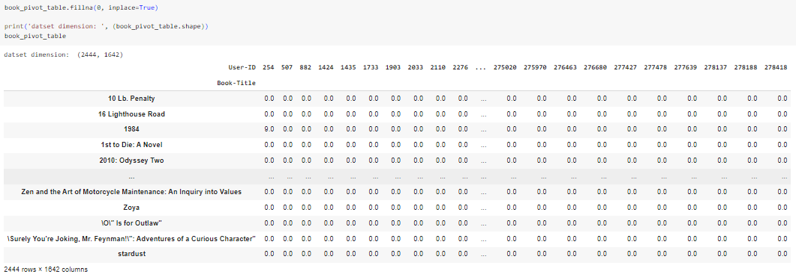
EXPLORATORY DATA ANALYSIS
Creating a Pivot table where Rows represent the User-ID and columns represent the Book Title.
Here we have to observe that only 0.16% of users rated more than 100 books, and only 0.9% of books were rated more than 50 times by these avid readers.

Slide 7
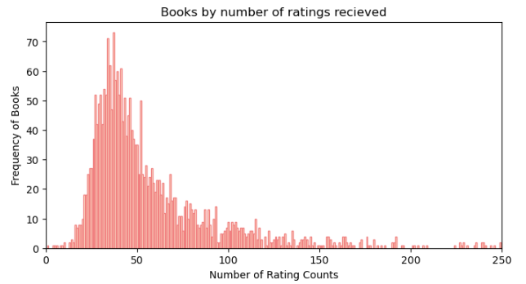
EXPLORATORY DATA ANALYSIS
We have Group the data by each book and counted how many ratings each book has received, Calculated how many books fall into each rating count category, and then sorted these counts. Plotted the histogram.
we can observe that around 25 books have received approximately 35 ratings each. The majority of books fall within the range of 25 to 100 total ratings, indicating that most books have moderate engagement from users.
There are very few books with rating counts exceeding 150, highlighting the rarity of highly rated books in our dataset. This insight will help us better understand the characteristics of our data as we move forward.

Slide 8
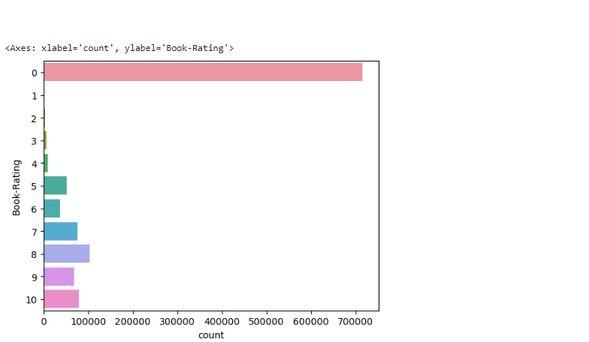
EXPLORATORY DATA ANALYSIS
In the Bar plot, we take ‘Count’ on the x-axis and “Book-Rating’ on the y-axis.
we observe, more than 7 lakh ratings have 0 ratings which is 62 % of the rating data that says that most users give no ratings and a large proportionate of them give very low no of ratings.

Slide 9
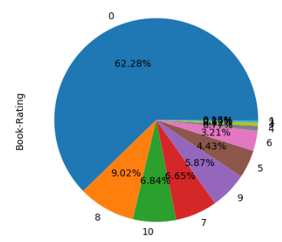
EXPLORATORY DATA ANALYSIS
The most common rating is 0, accounting for 62.28% of all ratings. This suggests that a significant number of users either did not rate the books they read or rated them very poorly.
The second most common rating is 10, accounting for 9.02% of ratings. This indicates that a smaller but still substantial number of users gave books the highest possible rating.
The remaining ratings are distributed relatively evenly, with 6.84% of ratings being 8, 6.85% being 7, 5.87% being 9, 4.43% being 5, 3.21% being 6, and 0.65% being 3.
Ratings of 1, 2, and 4 are relatively rare, each accounting for less than 1% of total ratings.

Slide 10
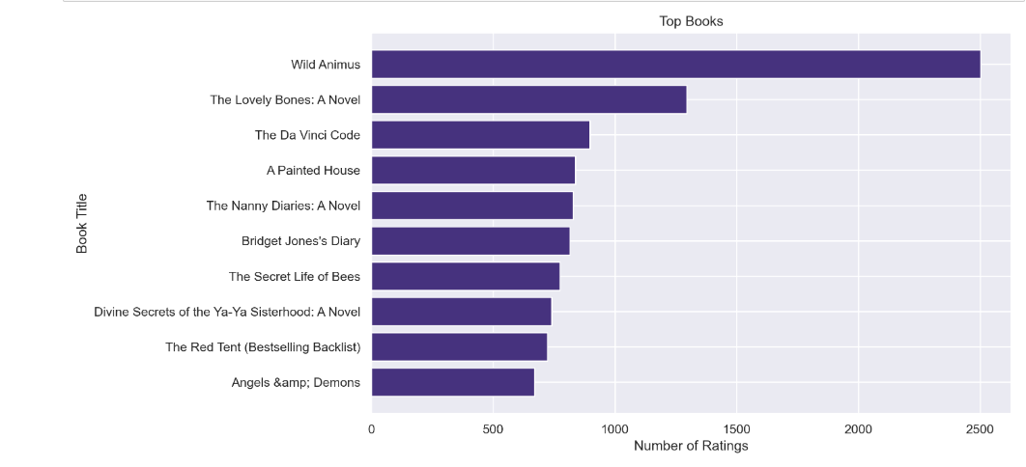
Graph shows top books
Wild animus is most rated books at 2500 ratings

Slide 11
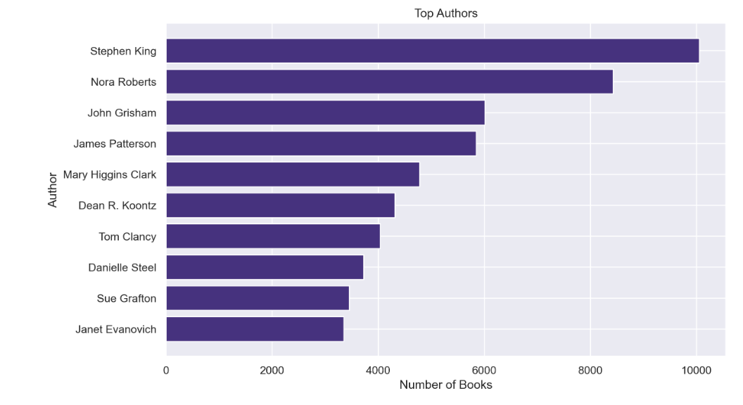
Graph shows top authors
Stephen king has most number of books at 10000 books

Slide 12
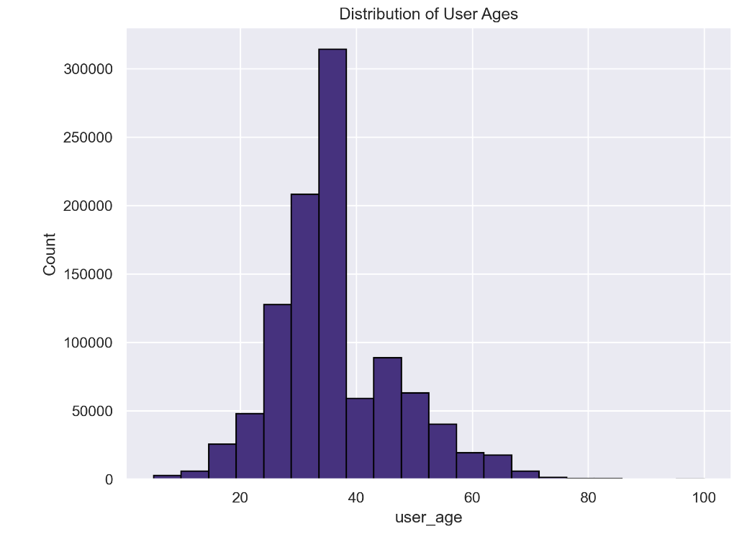
Graph shows distribution of user ages
Looking at the graph we can see most number of people are between
20 to 40 age

Slide 13
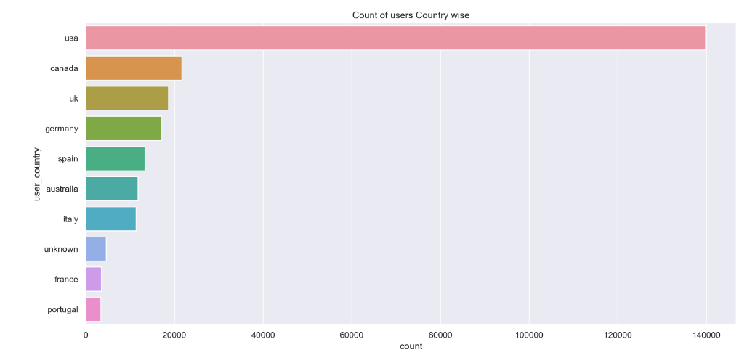
Graph shows count of users country wise
USA has most number of users, around 1,40,000 users

Slide 14
MODEL BUILDING
Collaborative Filtering.
Popularity Based Approach.
Clustering(Nearest Neighbors).

Slide 15
COLLABORATIVE FILTERING
Collaborative filtering is a technique used in recommendation systems to predict the preferences or interests of a user by collecting preferences from many users. It operates on the assumption that if two users have agreed on certain items in the past, they are likely to agree on other items in the future. It is widely used to recommend products, movies, books, or other content based on the preferences of similar users or items.

Slide 16
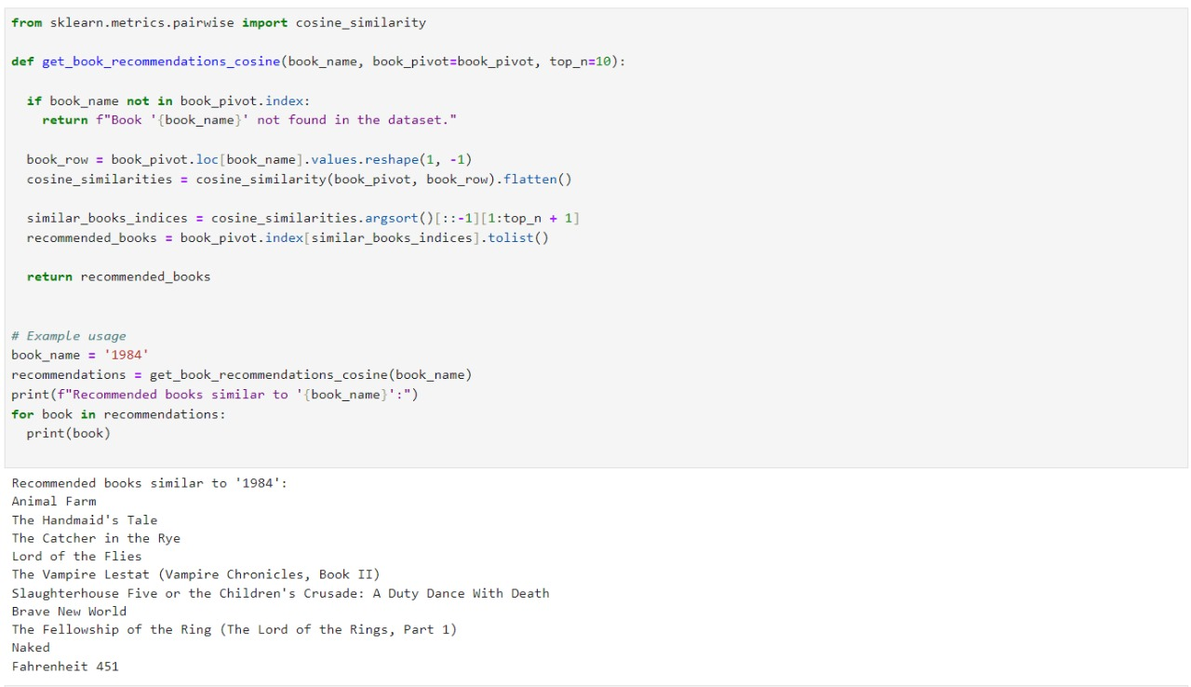
In this project we used cosine similarity between vectors in the matrix .
Cosine similarity measures the similarity between two vectors of an inner product space. It is measured by the cosine of the angle between two vectors and determines whether two vectors are pointing in roughly the same direction. Hence we can understand how 2 books are similar.
Here, the book “1984” is used as the input, and the function is called to get recommendations.

Slide 17
POPULARITY BASED APPROACH
It is a type of recommendation system which works on the principle of popularity and or anything which is in trend. These systems check about the books which are in trend or are most popular among the users and directly recommend them.

Slide 18
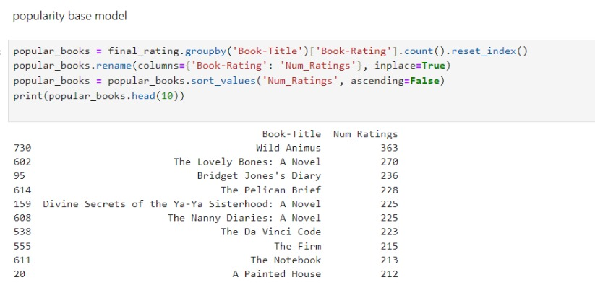
This method recommends books based on their overall popularity, which is usually measured by the number of ratings or interactions they have received.
The output shows the top 10 books along with the number of ratings they have received.
Wild Animus is the most popular book, having received 363 ratings, followed by “The Lovely Bones: A Novel” with 270 ratings .

Slide 19
CLUSTERING
Clustering is a technique that groups users or items with similar characteristics or behavior into clusters. The idea is that users or items within the same cluster share common preferences.
For the scope of our project, we used the K-Nearest Neighbors algorithm. KNN is a machine learning algorithm to find clusters of similar users based on common book ratings, and make predictions using the average rating of top-k nearest neighbors.

Slide 20
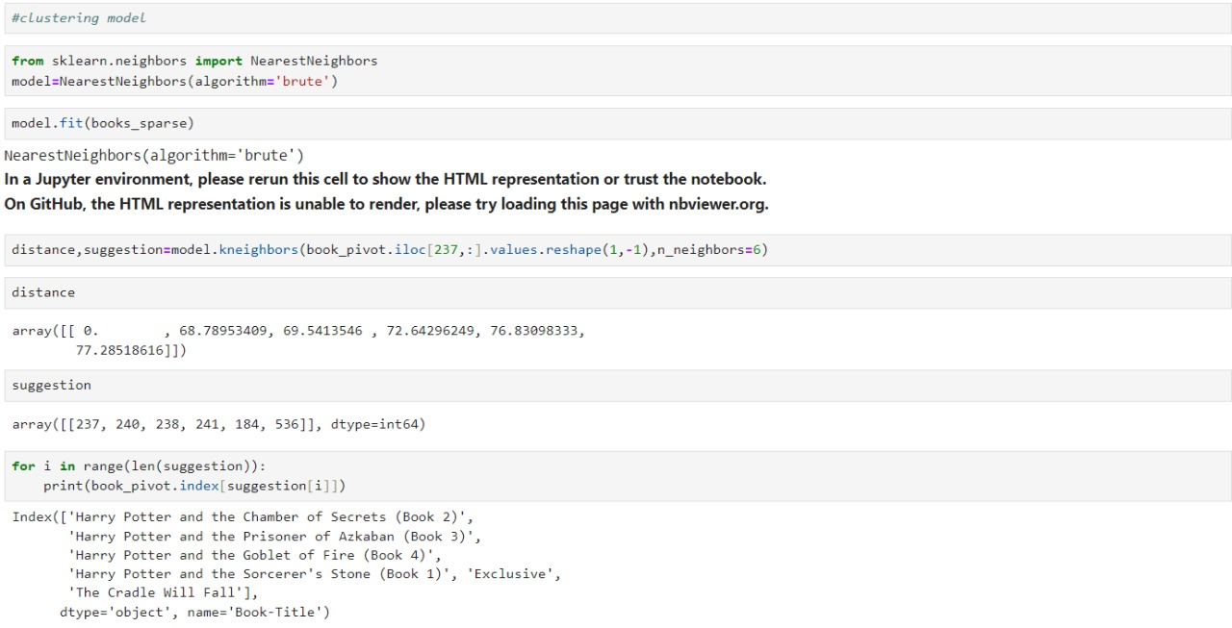
The algorithm we use to compute the nearest neighbors is “brute”.
The output shows the names of the 6 nearest neighbors to the book at index 237, which are all Harry Potter books.

Slide 21
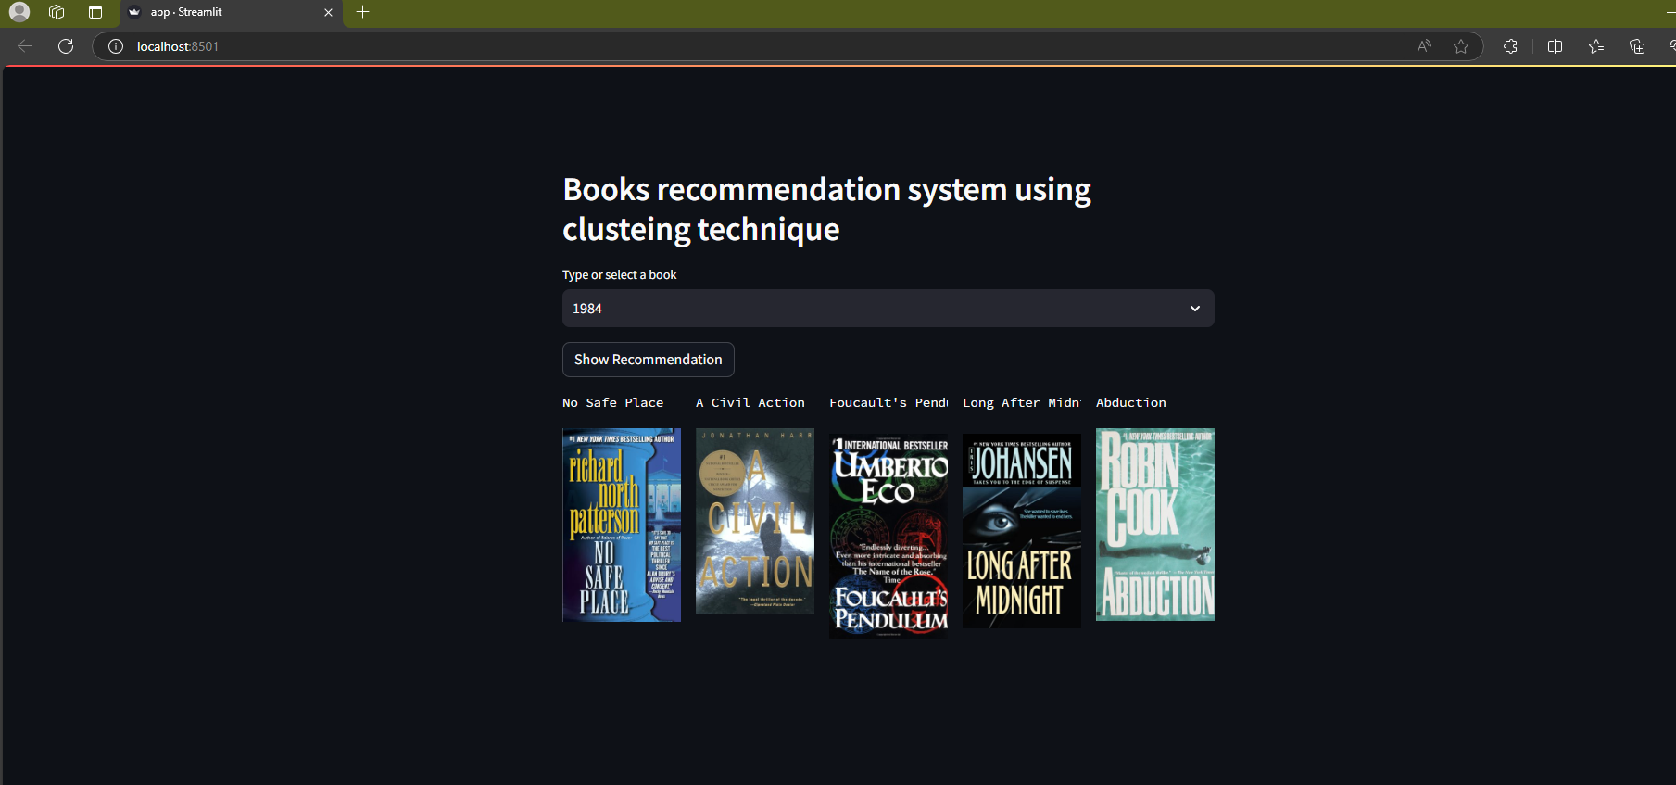
DEPLOYMENT
Users can select a book (e.g., “1984”) and the system suggests similar books in real-time.
Each recommendation displays the book’s cover.

Slide 22
CHALLENGES
There were significant missing values in several important columns.
The project involved working with three different datasets (Books, Ratings, and Users), which needed to be properly integrated for the recommendation system.
Working with book recommendation data typically involves large datasets, which can pose challenges in terms of processing time and memory usage.
Creating relevant features for a book recommendation system from the available data might have been challenging, especially considering the missing and inconsistent data
Decision making on missing value imputations and outlier treatment was quite challenging as well.

Slide 23
THANK YOU

